Slide 1
Module 3.2 – Computer Vision
Image Filtering and Hough Transform

Slide 2
Averaging Blur Filter
Blur (Averaging)
Averages pixels around a particular pixel
Applied in the same manner as other convolution masks
1 | 1 | 1
1 | 1 | 1
1 | 1 | 1
Notes:
Convolution masks can also be used to blur images
Here is an averaging convolution mask. This mask essentially computes the average value around a neighboring pixel and uses that average value as the new pixel value
The effect of this is to smooth out the image. If the image has some speckled noise, it is sometimes useful to apply a blurring filter to the image before performing other processing

Slide 3
Gaussian Blur Filter
It is a smoothing convolution mask with a higher weighting for the center pixel
0 | 1 | 0
1 | 4 | 1
0 | 1 | 0
Notes:
A Gaussian blurring filter is similar to the averaging filter except that the center pixel is weight heavier.
This type of filter is good for removing Gaussian noise from an image.

Slide 4
Thresholding Images
Thresholding is the process of converting a grayscale image to a binary image
A threshold operation is applied to each pixel
If the pixel value is above the threshold, then set the pixel value to 1
If the pixel value is below the threshold, then set the pixel value to 0
Notes:
Thresholding is the process of converting a grayscale image into a binary image
Each grayscale pixel is a single 8-bit value and the value needs to be converted into either 1 or a 0
The process then is to compare the pixel value against a constant (the threshold) and if the pixel value is equal to or above the threshold, then the pixel is set to 1 in the binary image
If the pixel value is below the threshold, then the pixel value is set to 0
There are various techniques to pick the threshold value and it often depends on what features you are trying to extract from the grayscale image

Slide 5
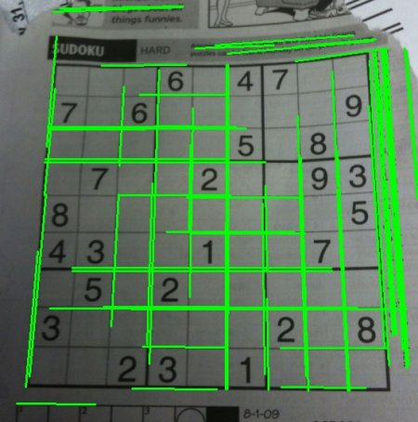
Detecting Lines in an Image
Use a process called the Hough transform
Given a set of points which are part of an edge, this algorithm finds a line
Notes:
Once edges have been extracted from an image, it is possible to extract candidate lines that represent those edges. These lines are equations that represent the edge location and angle.
The Hough transform is an algorithm that is used to find these lines

Slide 6
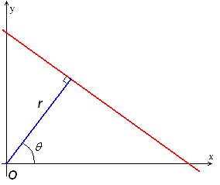
Line Representation
Lines can be represented by y = mx + b
Lines can also be represented in normal form
r = x cos Θ + y sin Θ
Where Θ is the angle of a line segment perpendicular to the line
r is the length of the line segment from the origin to the line
Notes:
In Cartesian space, lines can be represented with the equation y=mx+b
The Hough transform converts lines from Cartesian space into a Hough space represented by r and theta
Theta represent the angle of a line segment from the origin that is normal to the line
R is the length of the line segment from the origin to the line

Slide 7
Line Representation
Each line running through a point (x,y) has a corresponding (r,theta) value associated with it
If you plot the (r,theta) values for a point, you get a curve in the r,theta plane
If you plot all of the curves for all points, wherever they intersect the most is the best r,theta line running through the edge points
Notes:
Each potential line in an image running through a point (x,y) in the corresponding space has a corresponding point in the (r,theta) space. Each line in the Cartesian space is a point in the Hough space.
If you plot all the (r,theta) values for a given point in Cartesian space, this turns into a curve in the Hough space
Wherever several curves intersect in the Hough space, this is a potential line in the original image

Slide 8

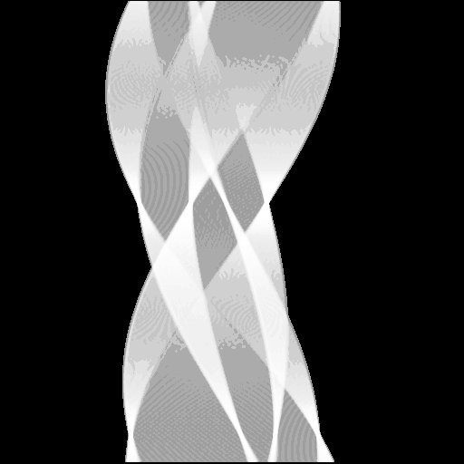
Line Representation
Notes:
The image on the left shows the curves in Hough space. Each curve represents all possible lines running through a particular point (x,y) in the Cartesian space.
The curves are emphasize in the image on the right for better visibility.
On the left image, you can see where the curves intersect. These show up as brighter points. These are locations in Hough space where multiple points have the same (r,theta) in Hough space and they are potentially points on the same line.
By thresholding the image on the left, you can obtain a set of points which represent lines in the original image.

Slide 9

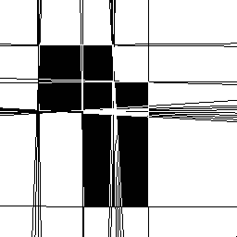
Line Representation
Notes:
The image on the left shows edges that were detected from an edge detector operation.
The image on the right shows the potential lines that were extracted using the Hough transform.

Slide 10
Hough Transform
Advantages
Tolerates gaps in edge descriptions
Relatively unaffected by image noise
Disadvantages
Lots of computation
Notes:
The Hough transform has its advantages and disadvantages
The advantages of the transform are that is can tolerate gaps that were detected using an edge detector. If there are gaps, there are still points that will map to the same (r,theta) line description.
Also, if there is noise in the edge detection stage, the Hough transform is relatively unaffected by the noise
The primary disadvantage is the amount of computation necessary for the Hough transform

Slide 11
The GPU Teaching Kit is licensed by NVIDIA and California Polytechnic State University under the Creative Commons Attribution-NonCommercial 4.0 International License.

